Slide 1
CMPE189 Group 4 Project Diagrams
Key facts about your topic
The Internet of things is the extension of Internet connectivity into physical devices and everyday objects. Embedded with electronics, Internet connectivity, and other forms of hardware, these devices can communicate and interact with others over the Internet, and they can be remotely monitored and controlled.
Discussion:
Hardware and Software additional required installation
Hardware:
Requesting a good quality sensor and JTAG cable
Software:
CLI from IBM (Docker)
Hint: the software prerequisite has not been met our computer laptop
Requesting new PC platform such as Linux, Mac ios
Notes:
QuickStarter has created an outline to help you get started on your presentation. Some slides include information here in the notes to provide additional topics for you to research.
More key facts:
Academic conference: ICC 2016, GLOBECOM 2015, UbiComp 2014, CHI 2016, IOT 2015, INFOCOM 2016, ETFA 2016, WCNC 2016, PerCom 2016, WWW 2016, ICT 2015, PIMRC 2015, AINA 2016, SenSys 2015, CCNC 2016, VTC 2016, SECON 2015, LCN 2015, DCOSS 2015, IEEE CLOUD 2015, CIKM 2015, ICCCN 2015, MOBIQUITOUS 2015, HICSS 2016, ISCC 2015, ICEIS 2016, MDM 2015, VLDB 2015, ICDCS 2016, IWCMC 2015, EWSN 2016, ICDE 2016, ICES 2014, ICASSP 2016, WISE 2015, ACM MobiCom 2015, NEW2AN 2015, IEEE VR 2015, CIT 2015, WICON 2014, HPCS 2015, CIAC 2015, MoMM 2014, ICN 2016, ADBIS 2015, SMC 2016, WoWMoM 2016, SIGCOMM 2016, MUE 2015

Slide 2
Related topics to research
IBM Node-RED Watson IoT
Arduino
Amazon Web Services
NodeMCU
ESP8266
3D printing
Semantic Web
SAP SE
Virtual private network
Smart contract
Google Cloud Platform

Slide 3
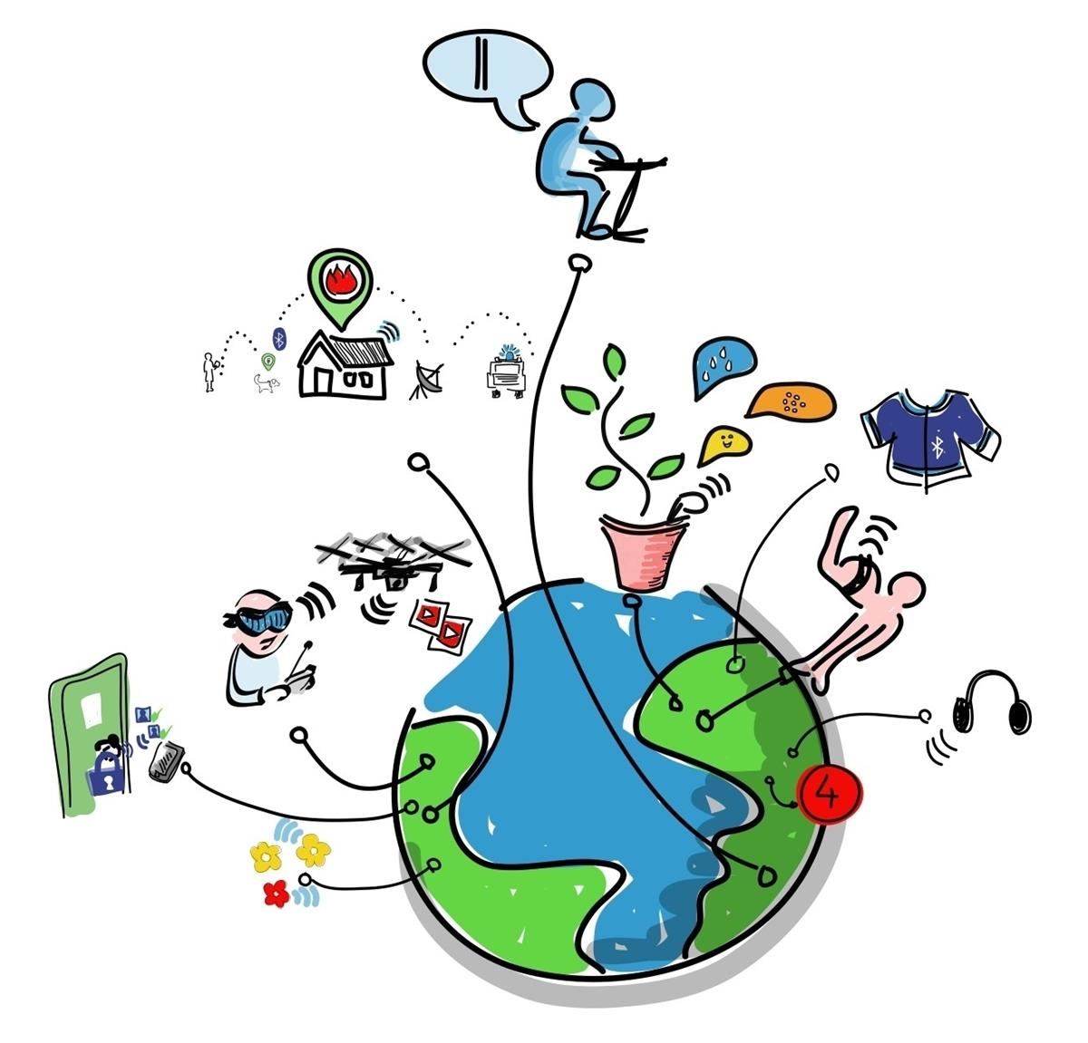
Internet of Things
CMPE 189 Internet of Things
Group 4

Slide 4

Contents
Applications
Trends and characteristics
Enabling technologies for IoT

Slide 5

Applications
Notes:
Consider talking about:
Consumer applications
Commercial application
Industrial applications
Infrastructure applications

Slide 6
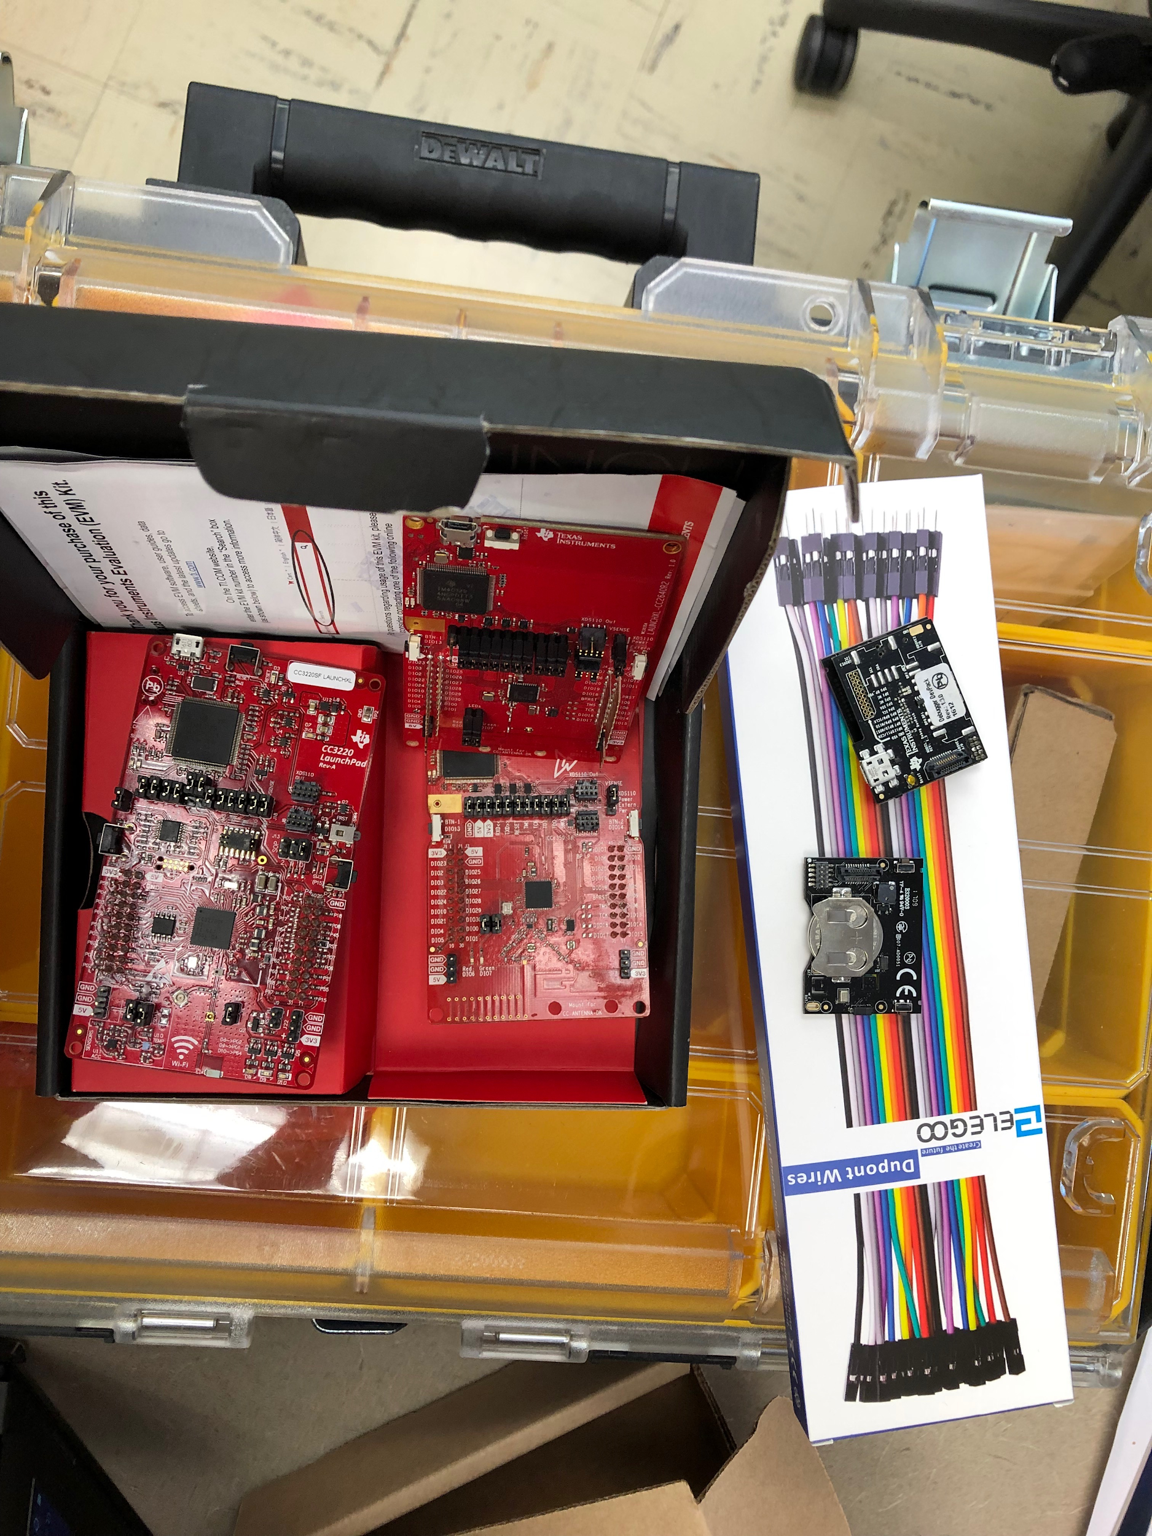
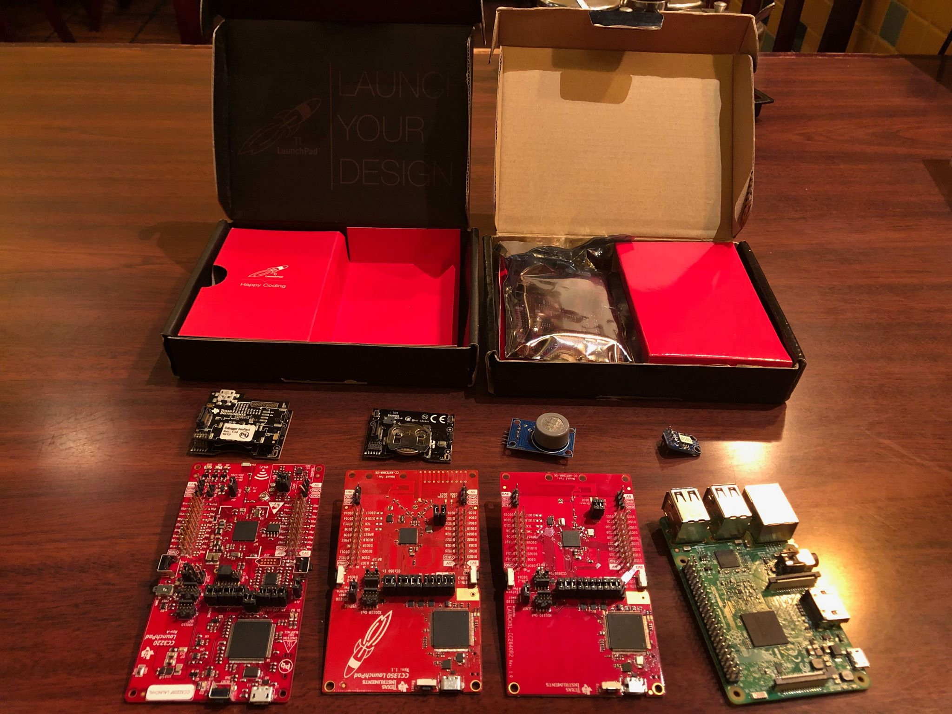
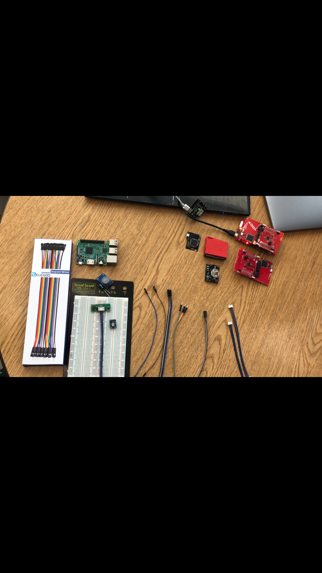

Slide 7

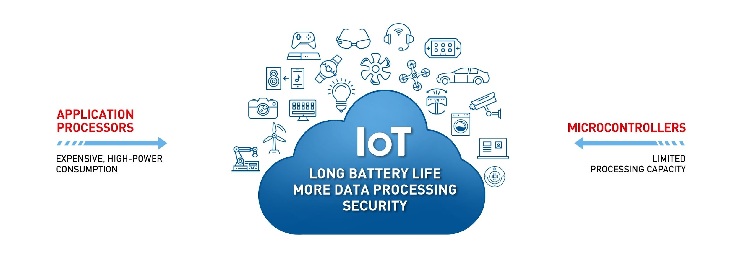
CSS/IBM Gateway
CC3220SF
CC1350
Sensor Tag
Airflow sensor

Slide 8
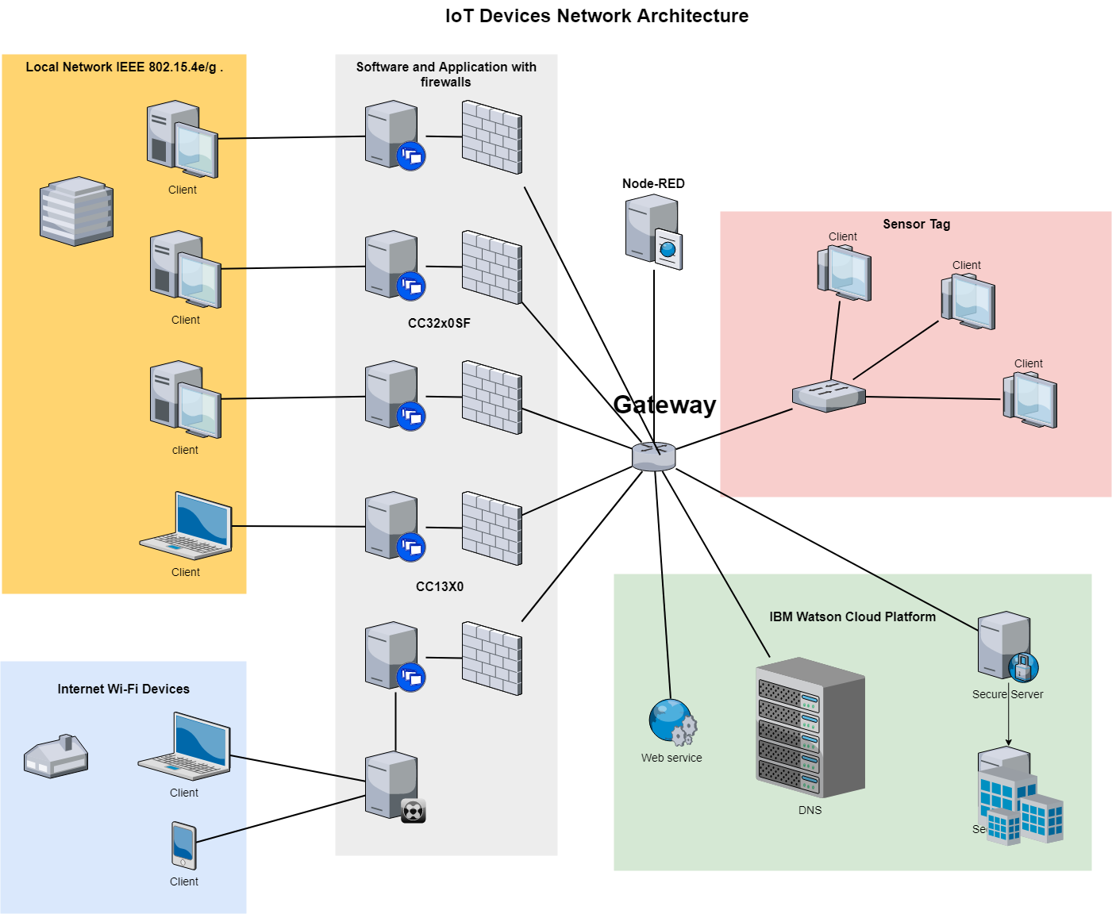

Slide 9
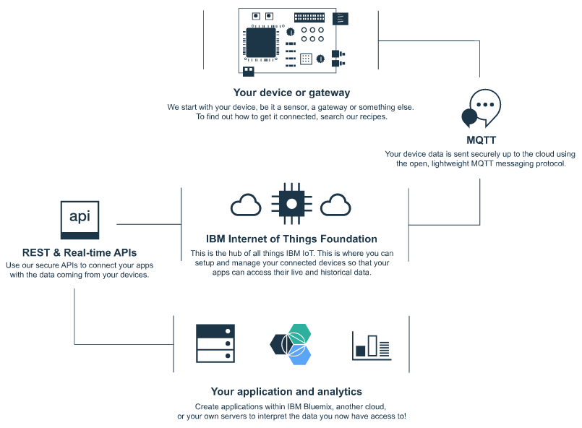

Slide 10
Trends and characteristics
Notes:
Consider talking about:
Intelligence
Architecture
Complexity
Size considerations
Space considerations
A solution to "basket of remotes"

Slide 11
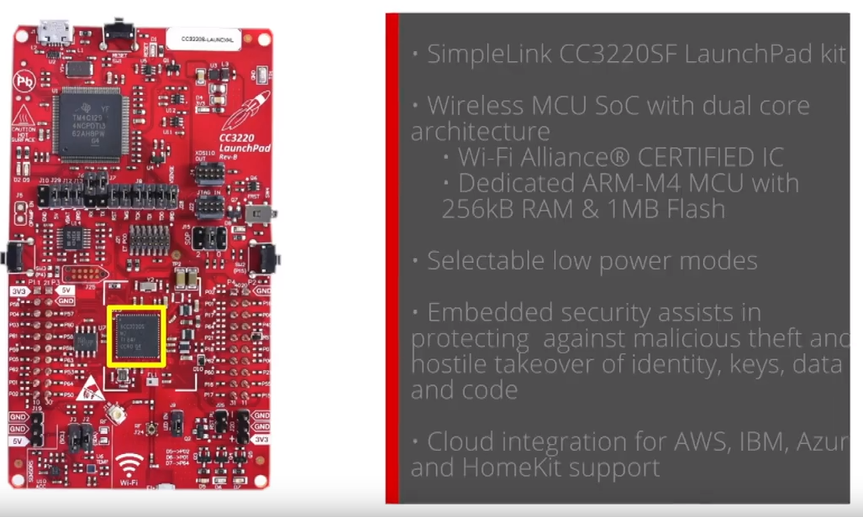
MCU/CC3220SF LaunchPad

Slide 12
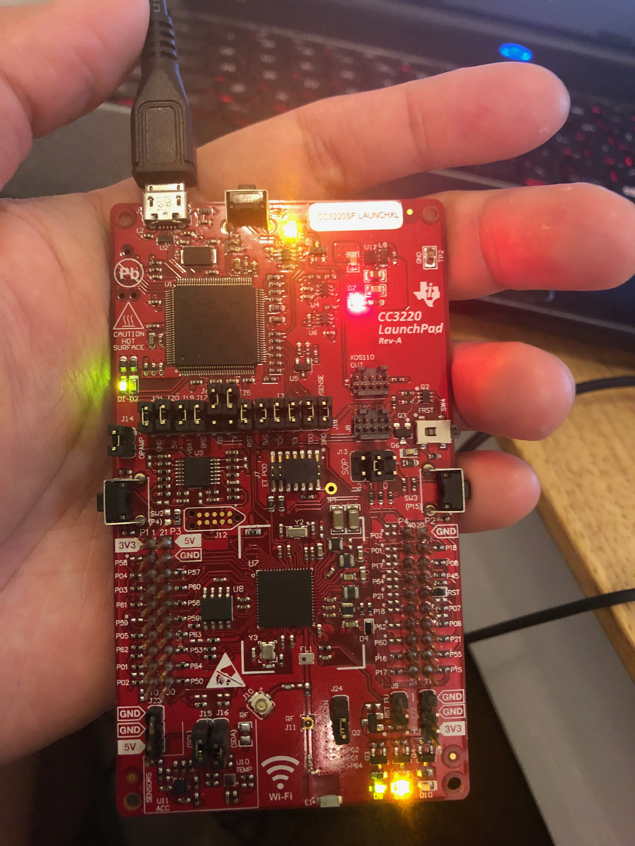
We are using TI 15.4 stack network for IBM Gateway by using Sub 1 technologies.
Within the IoT network, we managed the end-to-end nodes directly to the cloud services in our device activities. The connection via the internet (Wi-Fi) is the benefit of a low power device.

Slide 13
Enabling technologies for IoT
Notes:
Consider talking about:
Addressability
Medium-range wireless
Long-range wireless
Wired
Standards and standards organizations

Slide 14
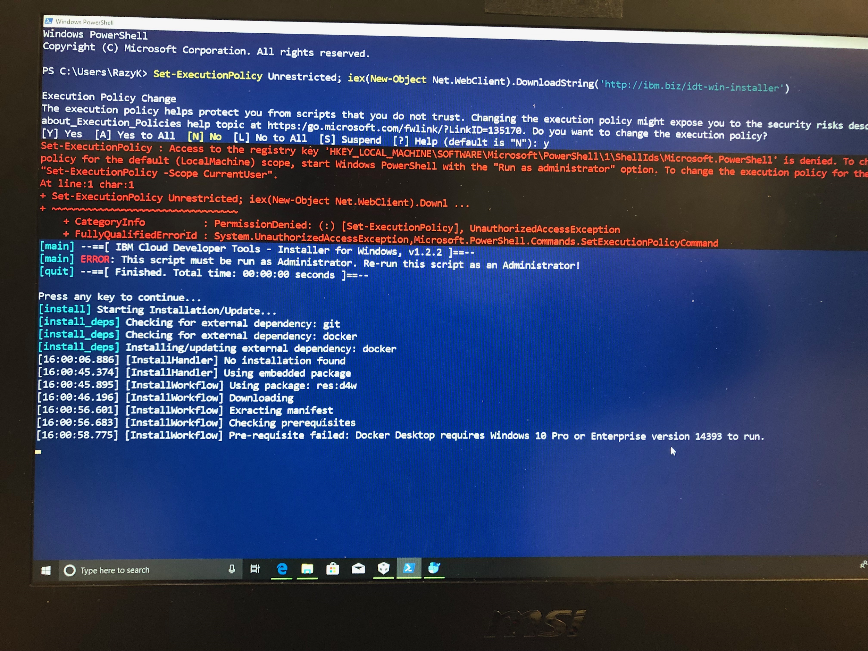
The IBM application needed additional installation software “CLI-IBM-Docker.”
After the installation, if the users have nothing wrong with the software; the users can launch the application via the “Powershell” command line for Window
Example, cf api https://api.ng.bluemix.net

Slide 15
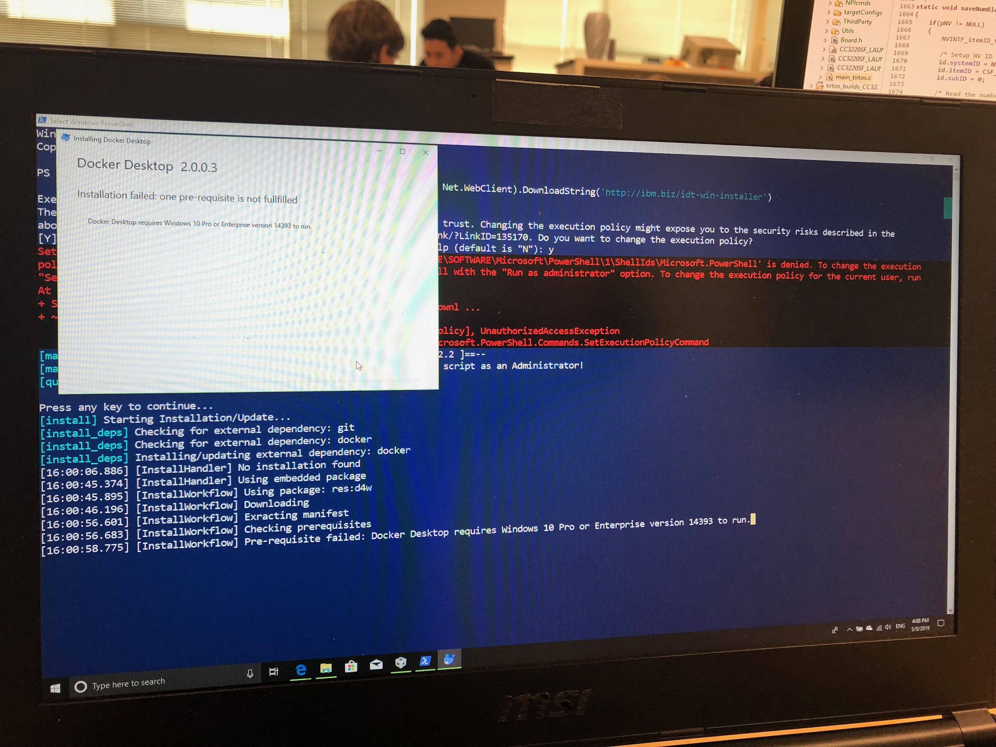
Similarly to the previous figure; here is another example that shows the failure of the software installation.
Unfortunately, our team members found out that the CLI software needed the latest Windows version 10 Pro only.
So, we needed to directly go with Linux instead.

Slide 16
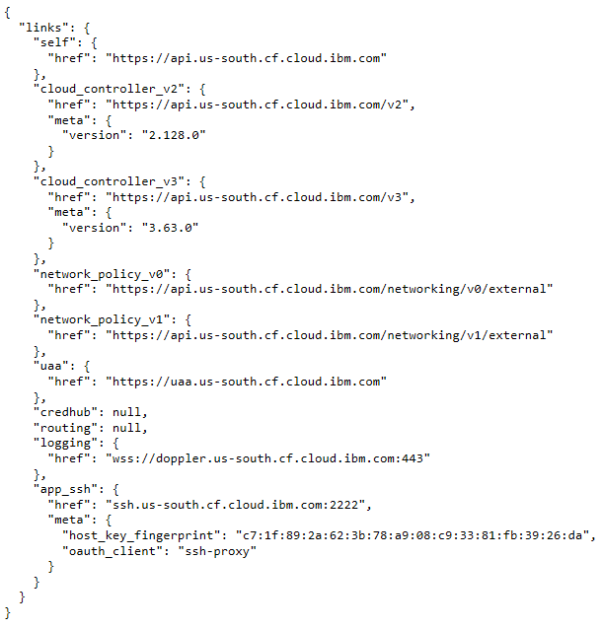
More importantly, the users need to check IBM network policy before using the cf command line regarding the connection of the IBM application

Slide 17
References
https://www.ibm.com/blogs/bluemix/2015/07/scaling-to-100k-devices-with-iot-on-bluemix/
https://www.cypress.com/solutions/internet-things-iot

Slide 18
TI-CC3220 Trending
https://www.youtube.com/watch?v=r9oGbgbOZrM
https://www.youtube.com/watch?v=hP5QE_DyKp0
More relevant link to CC3220 project
https://www.youtube.com/watch?v=3B5sttB1Dwk
https://www.youtube.com/watch?v=84AarmVjeUI
https://www.youtube.com/watch?v=qzSABBi46_w
https://www.youtube.com/watch?v=ReMkE6vTQV4
https://www.youtube.com/watch?v=BcakVMhDq_w&t=29s

Slide 19
http://www.ti.com/lit/ug/tidud09a/tidud09a.pdf
This link was our group’s main reference for the project. It gave us the general guidelines for how to implement our project.

